Slide 1
Extend and Explain: Interpreting Very Long Language Models for Extracting Medical Conditions from Clinical Documents
Paper: https://proceedings.mlr.press/v193/stremmel22a.html
Code: https://github.com/Optum/long-medical-document-lms
Joel Stremmel, Brian Hill, Jeffrey Hertzberg, Jaime Murillo, Llewelyn Allotey, Eran Halperin
Notes:
Thanks for the opportunity to present today.
My name is Joel, and I’ll be presenting work done in collaboration with Brian, Jeff, Jaime, Lou (no longer at Optum), and Eran.

Slide 2
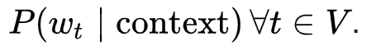

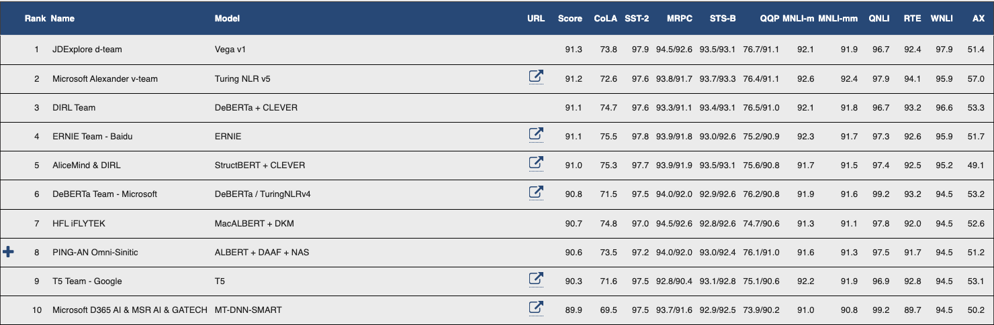
Language models have enabled monumental strides toward human-level performance in NLP tasks
GLUE: General Language Understanding Benchmark (human baseline: 87.1)
“Human vs. Muppet: A Conservative Estimate of Human Performance on the GLUE Benchmark” Nangia and Bowman
Notes:
The GLUE or General Language Understanding Benchmark came out in 2019 as a collaboration between NYU, The University of Washington, and DeepMind.
It consists of a variety of NLP tasks ranging from easy to very difficult. Easy tasks include sentiment classification and semantic similarity classification, while hard tasks include logical entailment of conclusions from premises, pronoun reference classification, and question answering.
Some datasets in GLUE are intentionally very small, encouraging the use of LMs pretrained to learn general language representations.
Recall that a language model is any model that predicts a token (think of a word) using context tokens. Large, Transformer-based LMs typically rely on self-attention mechanisms that encode notions of how relationships between words in a sequence are relevant to the task of predicting missing words. The typical training procedure for these LMs is masked language modeling based on bi-directional context.
Sure enough, models like DeBERTa shown here are trained using masked language modeling. DeBERTa was the first model to beat the human baseline on an even more challenging version of this dataset called SuperGLUE. Human baselines are based on experiments with Mechanical Turk and related platforms.

Slide 3
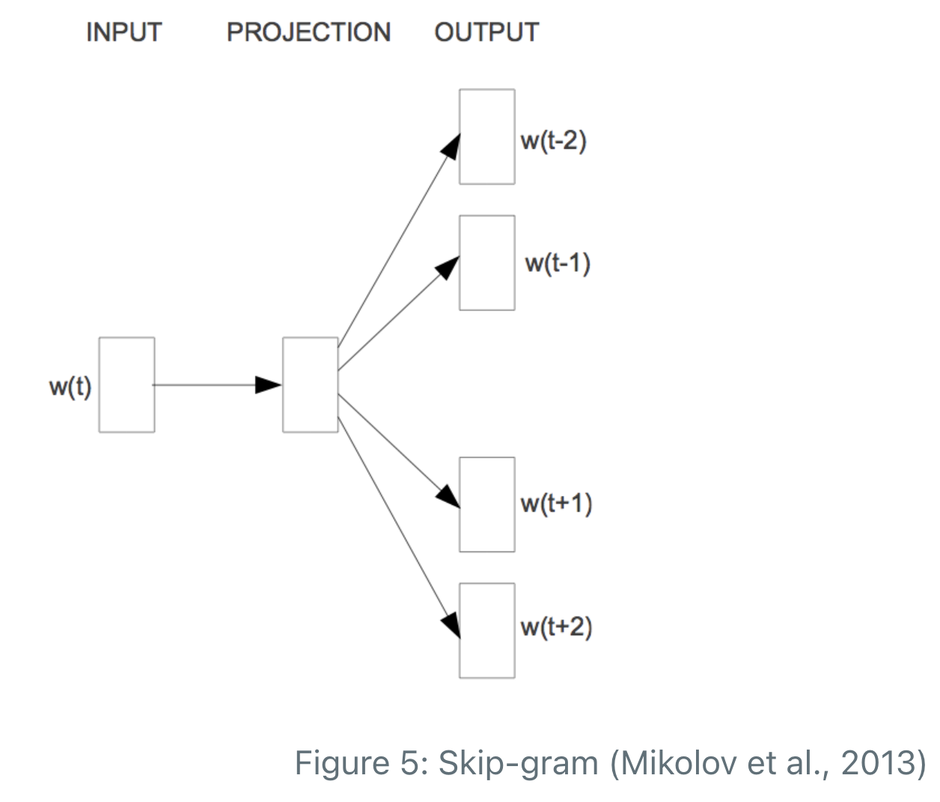
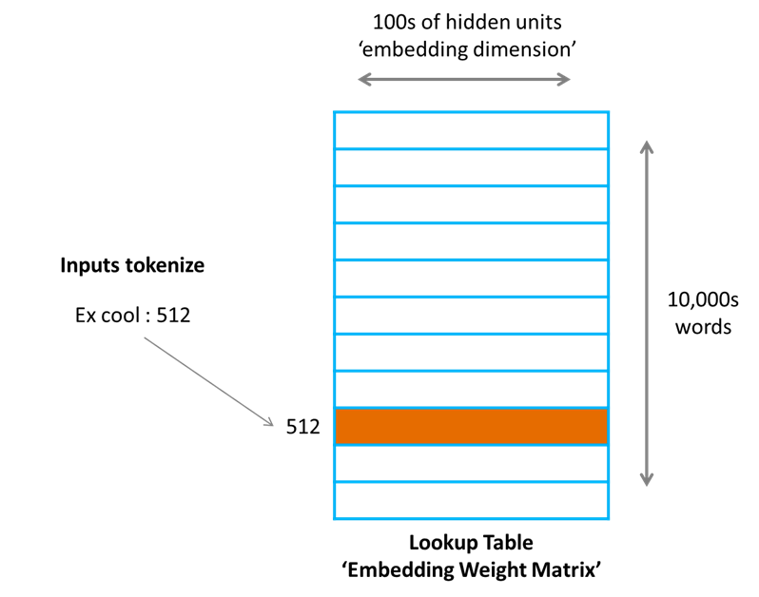
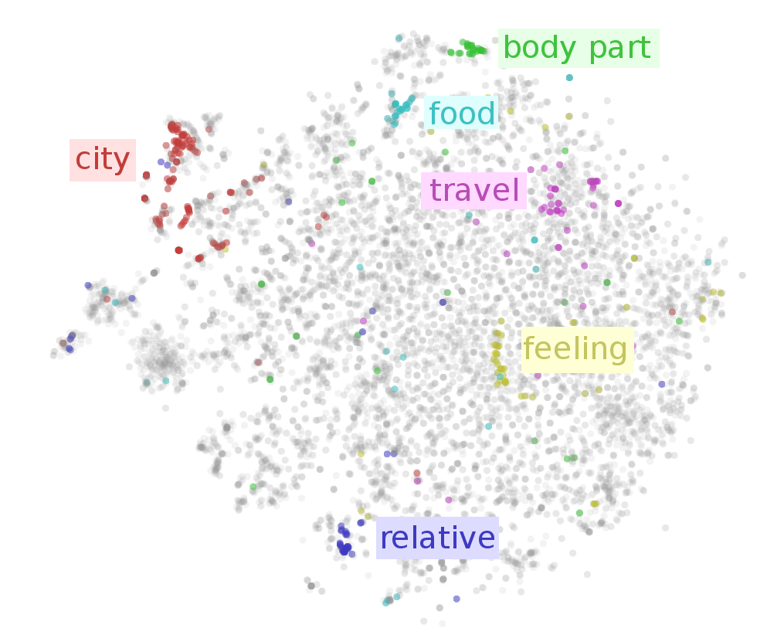
Evolution of Text Representation – Word Vectors
Bag of words: sparse vector representation of words:
Term frequency (original bag of words from Harris): vector of relative log scaled term frequencies adjusted for document length
TFIDF from Jones: scale term frequencies by log scaled inverse fraction of documents containing a given word
Embeddings: dense vector representations of words:
GloVe from Pennington et al.: Learn word vectors based on the probability of word co-occurrence across a text corpus
Word2vec from Mikolov et al.: Learn word vectors by training and extracting the hidden representation from a neural network used to reconstruct word context. “You shall know a word by the company it keeps” – Firth.
FastText from Bojanowski and Grave: Learn word vectors by summing character level n-gram vectors based on character level n-gram context (predict target n-gram given context or vice versa). Provides a representation of stems/suffixes.
Random Projection: from the Johnson-Lindenstrauss lemma, words in a vector space of high dimension can be projected into a lower-dimension preserving relative distance. In DL, we learn the lower-dimension representation from one-hot arrays projected to random vectors by training a task-specific NN.
https://towardsdatascience.com/what-the-heck-is-word-embedding-b30f67f01c81
https://ruder.io/word-embeddings-1/
Notes:
Performance of random projection catches up to pretrained word embeddings when used as a way to represent input text for supervised learning tasks as the dataset grows. That said, using pretrained word vectors can reduce training time.

Slide 4
Word Vector and Word Embedding-Based Model Limitations
No longer SOTA but potentially useful if bias can be mitigated
TFIDF vectors do not encode word order, though they can encode some context using n-grams, typically windows of all 3 or 4-word phrases.
TFIDF vectors struggle with negations, though n-grams can help.
Every word in a word embedding maps to one vector, including homonyms like “discount,” “bat,” “fine,” “second,” and yes… “bank.”
Word embeddings depend on fixed vocabularies.
Co-occurrence statistics might differ between pretraining and inference data.
“Sentences are the primary vehicles of meaning” – Quine.
RNNs like LSTMs process sequences of vectors one at a time and are hard to parallelize.
Word embeddings encode bias, e.g., in Ethayarajh et al. This topic deserves its own presentation. Good text representations are fair and unbiased.

Slide 5
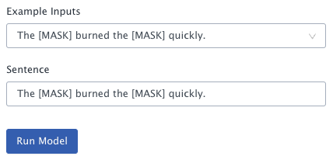
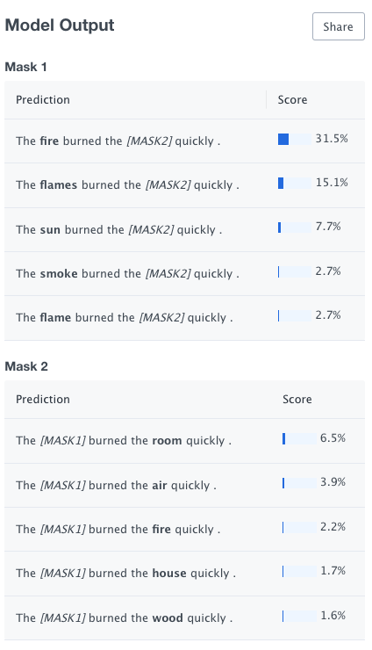
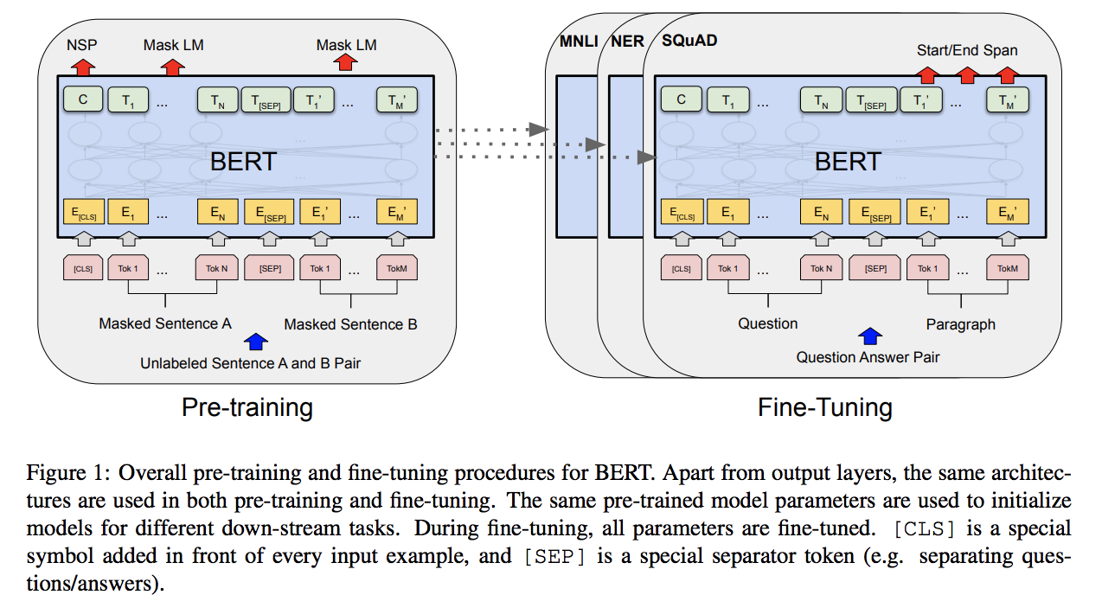
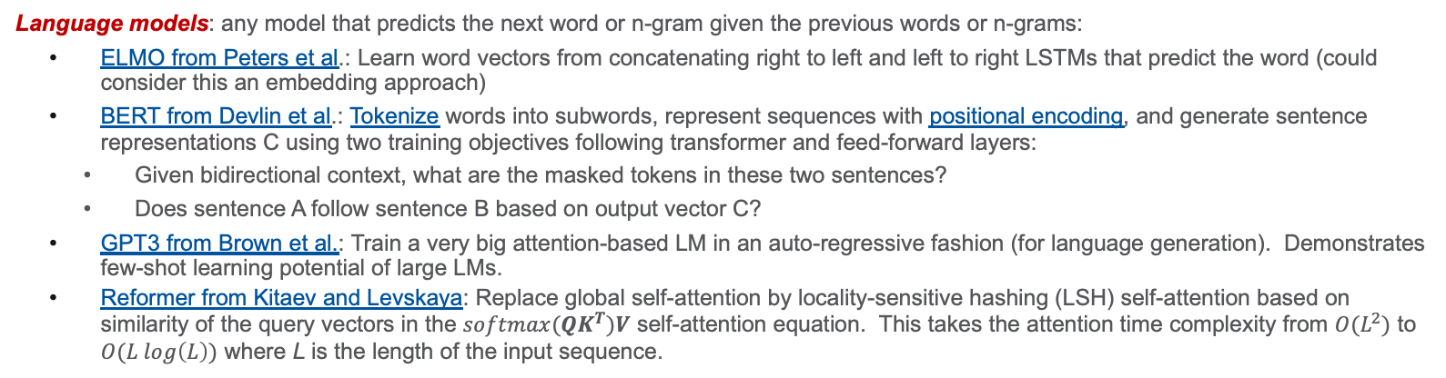
Evolution of Text Representation – Language Models
All but ELMO rely on the transformer architecture – next slide
Language models: any model that predicts the next word or n-gram given the previous words or n-grams:
ELMO from Peters et al.: Learn word vectors from concatenating right to left and left to right LSTMs that predict the word (could consider this an embedding approach)
BERT from Devlin et al.: Tokenize words into subwords, represent sequences with positional encoding, and generate sentence representations C using two training objectives following transformer and feed-forward layers:
Given bidirectional context, what are the masked tokens in these two sentences?
Does sentence A follow sentence B based on output vector C?
GPT3 from Brown et al.: Train a very big attention-based LM in an auto-regressive fashion (for language generation). Demonstrates few-shot learning potential of large LMs.
Reformer from Kitaev and Levskaya: Replace global self-attention by locality-sensitive hashing (LSH) self-attention based on similarity of the query vectors in the $softmax(QK^{T})V$ self-attention equation. This takes the attention time complexity from $O(L^{2})$ to $O(L log\left(L\right))$ where L is the length of the input sequence.
RETRO from Borgeaud, Mensch, and Hoffmann: Augment LM token similarity scoring with a database
LaMDA from Thoppilan et al.: Combine many large LMs for dialog and augment with human safety constraints
gMLP from Liu et al.: Achieve similar results to basic transformers with gated MLPs
https://github.com/federated-learning-experiments/fl-text-models
https://demo.allennlp.org/masked-lm?

Slide 6
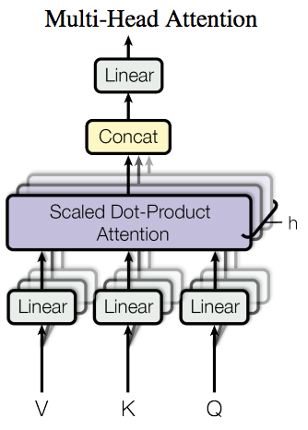
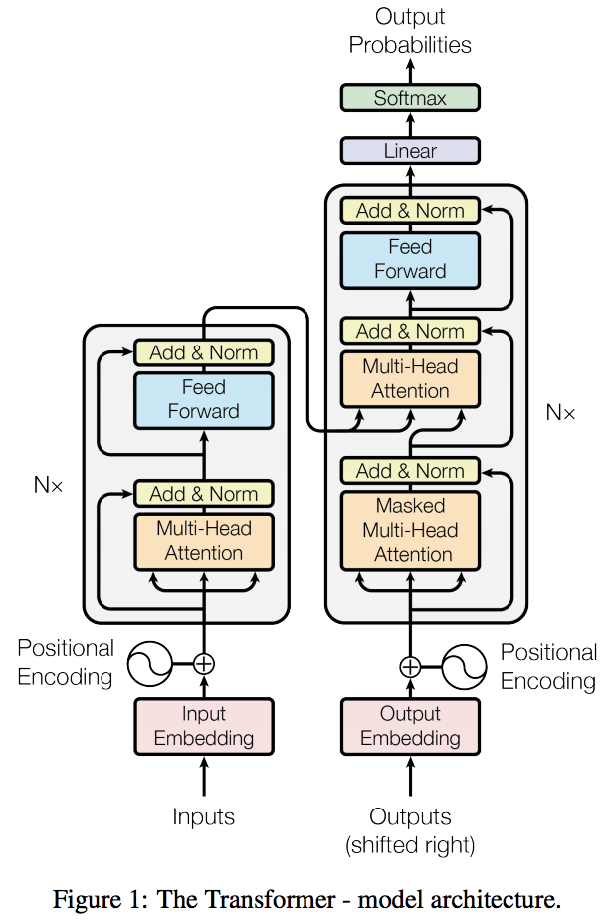

Key Innovation: The Transformer – Attention is All you Need
Transformers like BERT are language models that scale and generalize, enabling useful text representations for domain specific tasks like translation, classification, question answering, and named entity recognition.
Transformers do not use recurrent or convolutional layers. Instead, an encoder decoder architecture is used to model an input sequence and output sequence with self-attention layers that learn context-dependent representations of the tokens in each sequence 🙌.
“Multi-head attention allows the model to jointly attend to information from different representation subspaces at different positions.” – Vaswani et al.
“Attention is All You Need” by Vaswani et al.
“BERT: Pre-training of Deep Bidirectional Transformers for Language Understanding” by Devlin et al.
Notes:
If the softmax operation identifies one particularly strong signal in the self attention operation of one head, other heads might identify other relationships, enabling the model to learn more information about how relationships between tokens helps minimize the training objective.

Slide 7
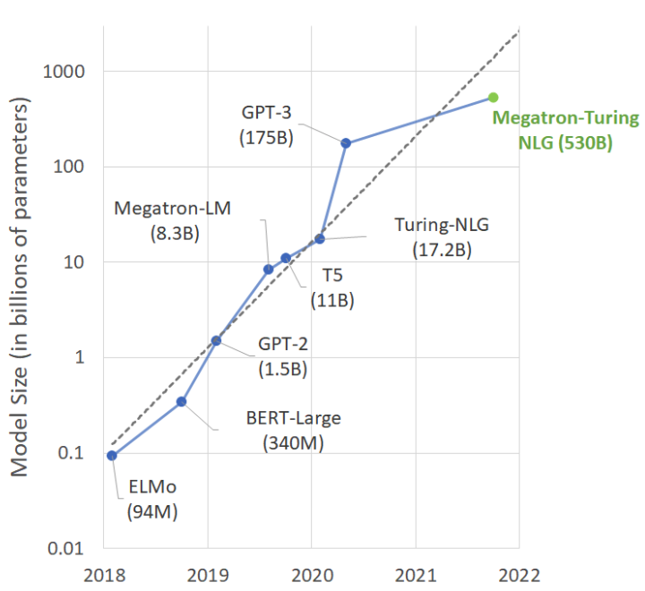
Model Sizes: Bigger is Better in Terms of Raw Performance
Considerations
Training large LMs is an engineering challenge. This is an important area of research.
Overparameterized networks challenge our assumptions about the bias-variance tradeoff. These models trained with SGD can still generalize, performing well on unseen data. See Learning and Generalization paper from Allen-Zhu et al. and Double Descent paper from Belkin et al.
How can we innovate in terms of representation/inductive bias instead of just scaling model capacity?
https://developer.nvidia.com/blog/using-deepspeed-and-megatron-to-train-megatron-turing-nlg-530b-the-worlds-largest-and-most-powerful-generative-language-model/
BUHG BIRD (136M)
Notes:
Model sizes continue to grow, but we are now on the map thanks to tools like AzureML, PyTorch Lightning, and Fairscale

Slide 8
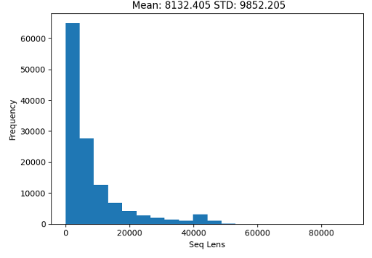
Major challenges exist for applying innovations in NLP to healthcare
The length of medical documents
The difference between clinical text and generic, English natural language
Scarcity of labelled data
Building trust in automated text processing systems
Lengths of Subword Tokenized Sequences from 128,000 Medical Charts from OptumInsight
BERT’s self-attention operation has O(L^2) time and memory complexity where L is the sequence length.
The max sequence length represented in practice is only 512 tokens.
Notes:
The things that make applying the best language models to healthcare difficult are also tremendous opportunities for Optum. We generate millions of labels as biproducts of regular business operations and have highly experienced clinical experts such as Jeff and Jaime.
One thing we probably can’t get away from is the need to work with long text. As patients have more encounters with the health system, the amount of text we have describing their medical history grows, and extracting specific details becomes more difficult.
CNN-based neural networks have been the architecture of choice for the last few years, due to both document length and computational efficiency.

Slide 9
Extend and Explain
Extend Opportunities
Explain Opportunities
Improve the ability to represent long-range dependencies in clinical text
Take advantage of unlabeled text data through transfer learning
Learn representations specific to a medical context and reuse for multiple clinical applications
Identify which text snippets drive the predictions of medical condition labels
Ensure the information being used to classify conditions makes clinical sense and isn't rooted in biased
Understand the types of relationships that LMs can identify between clinical narratives and disease categories
“Domain-Specific Language Model Pretraining for Biomedical Natural Language Processing” by Gu, Tinn, Cheng et al.
Notes:
Our research is focused on tackling the challenges that exist for applying NLP innovations to medical text, primarily the length of the text and the need for trust.
That said, because of the important differences between generic English text and narrative medical text, and because there are little to no publicly available LMs trained at the sequence lengths of interest to us, we also conduct in-domain pretraining, which has been shown to outperform generic pretraining when the dataset is sufficiently large.
We see a big opportunity to pretrain LMs of different flavors on the large corpora of medical text we collect as a part of business and clinical operations and apply them to a broad range of downstream tasks. We also take seriously the need to build trust in these models, which is especially difficult when the documents are very long, as we will soon show.
Explanation has some nice side benefits as well. For example, in our paper, our clinician collaborators discuss the types of relationships that LMs tend to learn from medical text, giving us insight into what sort of information we can extract at scale. For example, qualitative results suggest that LMs fine-tuned for text-classification effectively learn relationships between diseases and the drugs used to treat them.

Slide 10

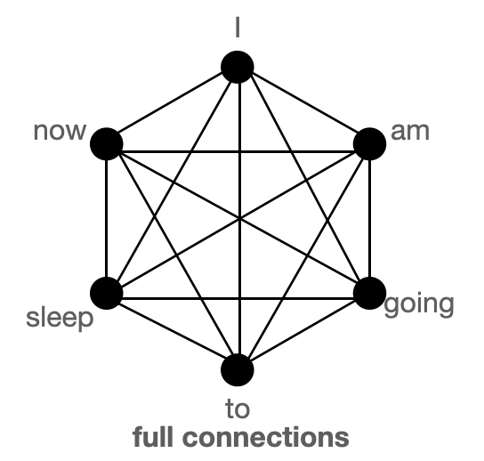
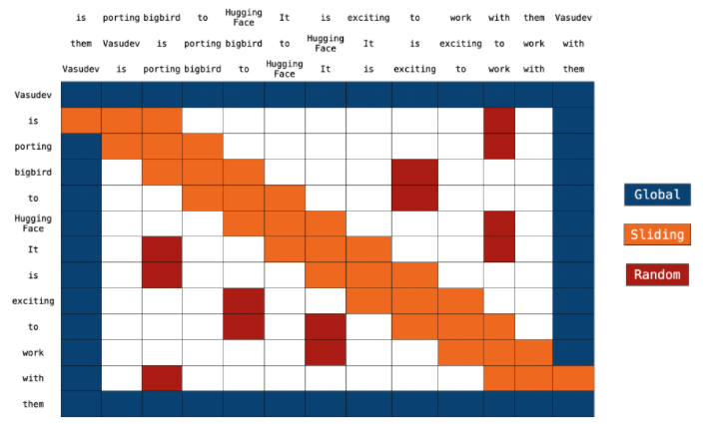
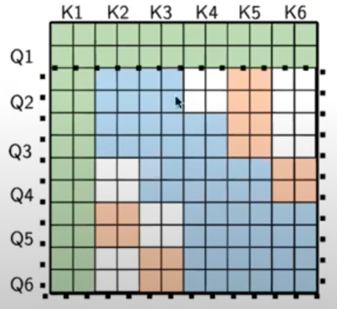
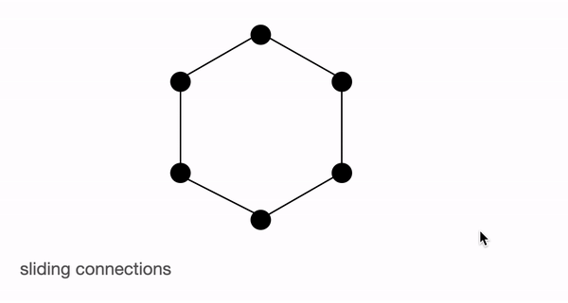
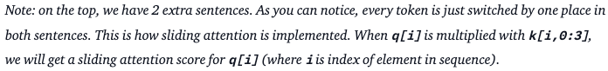
Big Bird Core Ideas
https://twitter.com/bigbird
Big Bird’s block sparse attention mechanism approximates full self-attention using a combination of global tokens, sliding window attention, and random graph approximations of fully connected graphs representing full self-attention.
These mechanisms take the memory consumption from $O(L^{2})$ where L is the length of the input sequence to $O\left(L\right)$ and make Big Bird a universal approximator of sequence-to-sequence functions.
In practice we have key and query vector representations of the tokens in the input sequence, and Big Bird selects tokens in blocks to minimize gather operations on sparse matrices.
https://huggingface.co/blog/big-bird
https://www.youtube.com/watch?v=_oSy_QvjHTs
“Big Bird: Transformers for Longer Sequences” by Zaheer et al.
Notes:
Big Bird is one of dozens of sparse-attention LMs designed for long sequences. Big Bird combines ideas from multiple other models and performs very well on “Long Range Arena,” Google’s benchmark for long text processing.
Big Bird is no longer state-of-the art on Long Range Arena, although its open-source implementation makes it a very popular choice for a long text, and its architecture is generally representative of how researchers have attempted to solve the problem of N^2 self-attention in BERT.
Big Bird uses a random graph approximation of full self-attention. Intuitively, Big Bird attempts to create a path between any two tokens in the input sequence, which would normally attend to each other under full self-attention, with the limitation that many layers might be required to connect any two tokens. This reduces the time and memory complexity for training the LM.
In practice, we observe that Big Bird outperforms both CNN-based approaches for text classification and approaches for combining predictions from shorter, full self-attention LMs like BERT. It has yet to be seen how the new state-of-the-art LM for Long Range Arena called S4 does on long medical text, but we view testing this as an extension of our current work, and we plan to discuss this in more detail tomorrow.
We also expect our explainability method, which we’ll discuss in a few slides, to be general to any text classification model and particularly well-suited to models that shortcut N^2 self-attention and operate on long text.

Slide 11
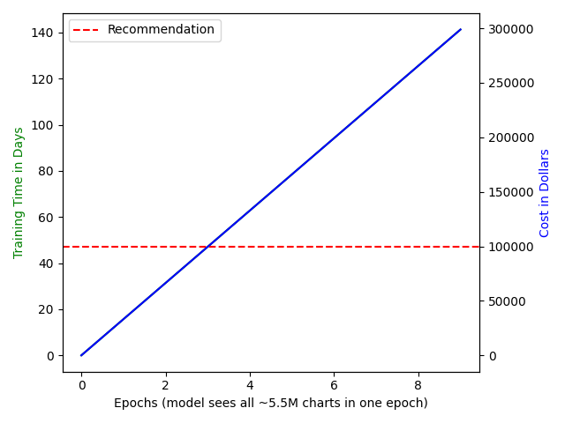
Extending is Easy… Sort of…
Ingredients to train on sequences of 32,768 subword tokens (8x published Big Bird):
Data Partitioning and Loading
Distributed Training
Footing the Bill
Partitions of the pretrain, train, validation, and test data from Spark cleaning and aggregation steps are pre-tokenized and masked one partition at a time on a single CPU machine with 672 GB RAM.
To accommodate train and validation sets of arbitrary size, sequences are chunked, saved, and loaded on different GPUs according to a mapping used by a distributed sampler. The mapping points a randomly sampled index to a file for that sample. Compare to how image classification models load and train on individual image PNGs.
Initial tests of saving 128k torch arrays for validation with pickle on Azureblobshare were very slow, taking about 500 files per hour.
Saving 128k numpy arrays with np.save is much faster, about 30k files per minute.
File loading is also significantly faster with numpy: reading 1000 files takes about 30 seconds, whereas it took about 30 seconds to read just one pickled torch array during initial tests.
We train Big Bird on a multi-node, multi-GPU cluster consisting of four-nodes each with eight GPUs.
PyTorch Lightning launches parallel training processes, one process per GPU, using DistributedDataParallel to train a copy of the model on each GPU and update model weights according to gradients averaged across processes.
To simulate training at a larger batch size, we use gradient accumulation. Only 1-2 sequences can fit in memory per 32GB GPU (depending on pretraining/fine-tuning).
“PyTorch Distributed: Experiences on Accelerating Data Parallel Training” by Li et al.
Notes:
Long Range Arena focuses on sequences of length 4,096 tokens. We suspect that few LMs designed for longer sequences exist in the public domain, as training time, and therefore cost, also grows with sequence length.
Training long LMs is an engineering challenge, even on V100 GPUs with 32 gigs of RAM per GPU where we can fit batches of just 1 or 2 sequences into memory on each GPU when the sequence length is 32,768. Training with multiple nodes and using gradient accumulation help increase the batch size for better estimates of the gradient with each weight update.
Data is partitioned and loaded such that different nodes and GPUs receive different samples of training data. Nothing here is novel, but putting the pieces together is a little tricky.
With multi-node training enabled, cost, not time, becomes the limiting factor. We pretrained for 3 full epochs, at which time, small decreases in validation loss began to take 10s of thousands of steps. Pretraining for longer could lead to a better LM for our data, but even with 3 epochs of pretraining, we observe substantial performance gains over our baselines.

Slide 12
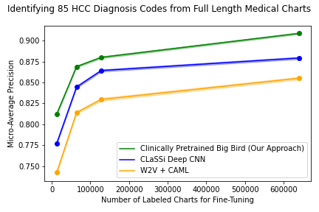
Predicting Medical Conditions from Optum Medical Charts
Performance on fine-tuning datasets of four sizes with 95% CIs
The Big Bird model pretrained on 5.5M medical charts identifies evidence of medical conditions corresponding to the 85 Hierarchical Condition Category Codes ~5% better than CAML and ~2-3% better than Deep CNN.
Notes:
The very long, clinically pretrained Big Bird model classifies charts having evidence of any of 85 HCC codes used for risk adjustment better than the production CNN model called CAML.
We implemented CAML using the same pretraining dataset as was used to pretrain Big Bird to create word2vec embeddings of word-level tokens to initialize the embedding layer. We also compared to a very deep CNN architecture, based on a paper from Facebook research.
Results are consistent across fine-tuning datasets of four sizes, the largest having 640,000 charts. When inferring on millions of charts, a few percentage points can translate into millions of dollars of savings.

Slide 13
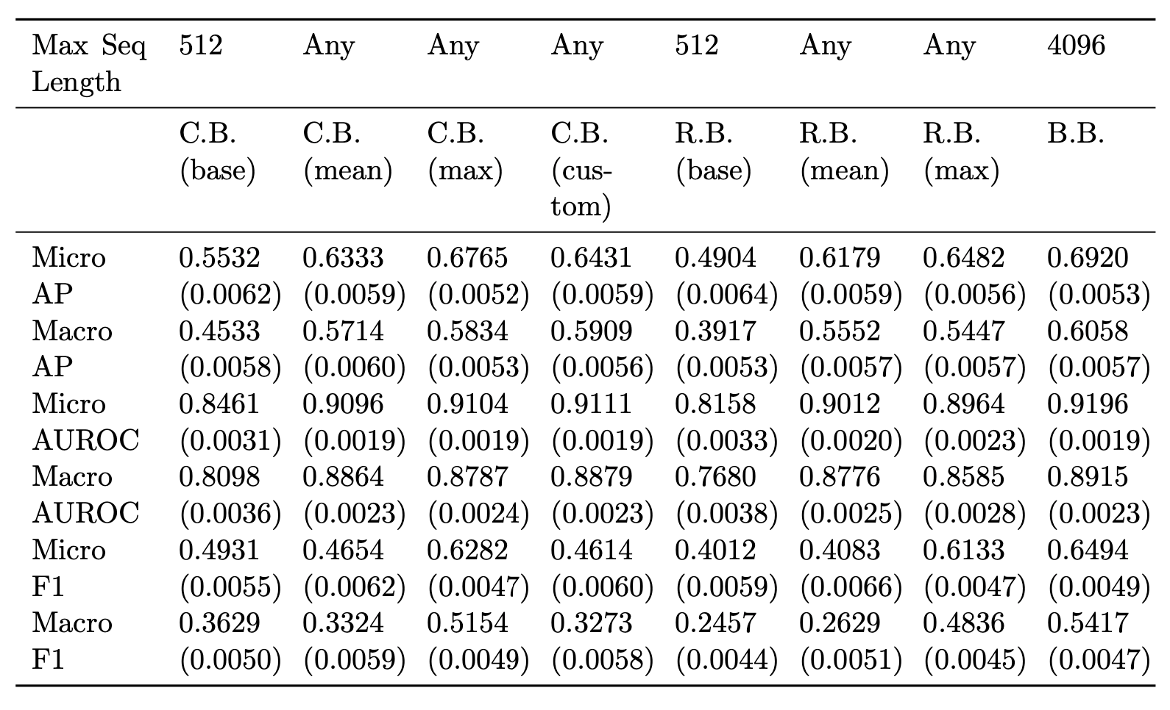
But can't we just use BERT in a different way...?
Off-the-shelf Big Bird (B.B.) vs windowed and pooled BERT flavors (C.B., R.B.) for predicting 50 ICD codes from MIMIC discharge summaries
C.B.: Bio-ClinicalBERT (Huang et al., 2020; Alsentzer et al., 2019); R.B.: RoBERTa (Liu et al., 2019); B.B.: Big Bird (Zaheer et al., 2021a)
For the Bio-ClinicalBERT and the RoBERTa models, the model’s max sequence length is shorter than the document length. Therefore, we evaluated several different methods for handling longer input sequences: truncation of the sequence to the model’s limit (base) and aggregating model outputs over windows of tokens using several different functions (mean, max, custom).
The custom aggregation function is described in equation 4 of Huang et al. Big Bird has a maximum sequence length of 4,096 tokens and is generically pretrained using MLM as described in Zaheer et al.
Notes:
A natural question is whether we can just use BERT over segmented and pooled representations of text instead of training very long LMs.
We found that on MIMIC discharge summaries, a Big Bird LM with a 4,096 token max sequence length outperforms multiple BERT models with multiple pooling approaches across all metrics for classifying 50 ICD diagnosis codes.
The BERT models were implemented using a 128 token overlap between segments, but still, clearly fails to capture important context. We tested a custom aggregation function proposed in a recent paper, but found that across two BERT flavors, max pooling the predictions over windowed segments performs best among all pooling approaches, but it still about 3-4% worse than Big Bird.

Slide 14
Generating Explanations for Long LMs
Masked Sampling Procedure (MSP) suited to long documents and sparse-attention LMs
Explaining why an ML model classified a document a certain way is extremely difficult, especially for long medical documents like patient medical charts. Existing methods:
Focus on individual words or tokens instead of full-length sentences.
Are prohibitively expensive in terms of runtime and are not well-suited to long documents.
Do not provide measures of statistical significance.
Fail to surface clinically informative explanations of predictions from medical documents.
Attention-weight analysis is also a poor option for long LMs. Not all tokens attend to each other.
MSP identifies text blocks that contribute to the prediction of document labels by masking many text blocks of size B tokens at once with probability P and measuring the impact on label predictions. We set the expected number of times a given text block is masked to be equal to J and average the impact of each text block on each label prediction from J/P total masking iterations.
When tested on medical document with disease diagnosis labels, MSP generated ~1.7x as many clinically informative text blocks and was ~100x faster than the state-of-the-art in the NLP literature (Jin et al. 2020).
The number of evaluations required by MSP is independent of document length unlike the state-of-the-art in which runtime is linear in the length of the document for individual text blocks and quadratic for identifying important text blocks pairs.
Notes:
On to the explain part of our research…
We developed a method to explain text-based classifiers, which are especially well-suited to long documents.
Other methods underperform on long documents in terms of both surfacing relevant text
and runtime. In fact, the current state-of-the-art from the ML literature took about 17 hours
to generate phrase-level explanations from a single discharge summary from the MIMIC-III database.
The runtime of our solution does not depend on the document length
and we compute measures of statistical significance for each phrase-level explanation.
We call our method the masked sampling procedure or MSP.
MSP could be used to explain the prediction of any labels from any documents,
but we focused specifically on medical documents and diagnosis labels.
We compared MSP to the Sampling and Occlusion algorithm from ICLR 2020, the current state-of-the art.
The Sampling and Occlusion algorithm was shown to outperform popular
explainability frameworks such as SHAP and Integrated Gradients for
explaining text classifiers on three datasets by measuring agreement
with human annotation and with explanations from logistic regression.
The idea of MSP is to generate a measure of importance for each text block in a document
based on that text block's impact on document labels. We measure the impact
of each text block by masking many text blocks of size K tokens at once
with probability P. Over many masking iterations, we can see
how masking any given text block impacted the predicted probability of each document label.
We implemented the Sampling and Occlusion algorithm and compared to our procedure, MSP,
using two clinicians to determine whether text blocks identified as important
using these algorithms were actually clinically informative.
We conducted the study as a blind experiment, and both clinicians
independently found that MSP outperformed Sampling and Occlusion.
In fact, MSP generated about 2 times the number of clinically informative text blocks
and ran about 100 times faster than Sampling and Occlusion.

Slide 15
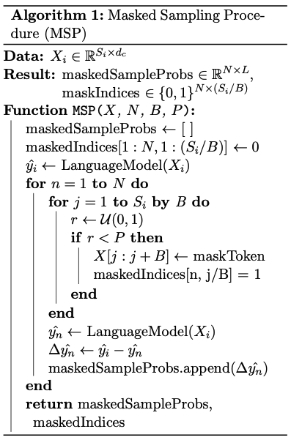
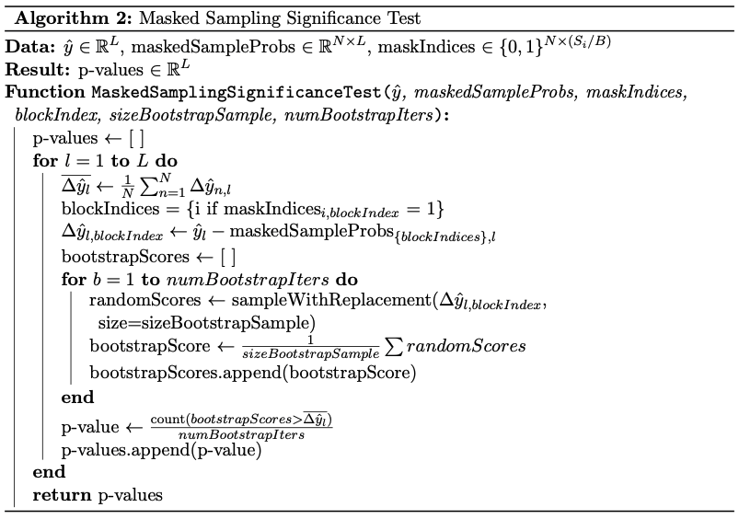
MSP Algorithms
Notes:
For reference, we provide pseudocode for MSP including computing p values. Note that we perform the masking procedure and the significance test in two steps. In our code, we write separate routines for generating explanations and preprocessing them. The explanation generation step is the slowest, as it requires running LM inference. Limiting the number of times we run inference to once per document, per sampling iteration, is a key innovation of our method. A possible improvement on our method would involved gathering masked sequences into batches and running parallel inference. We hope to discuss this more with Ben.

Slide 16
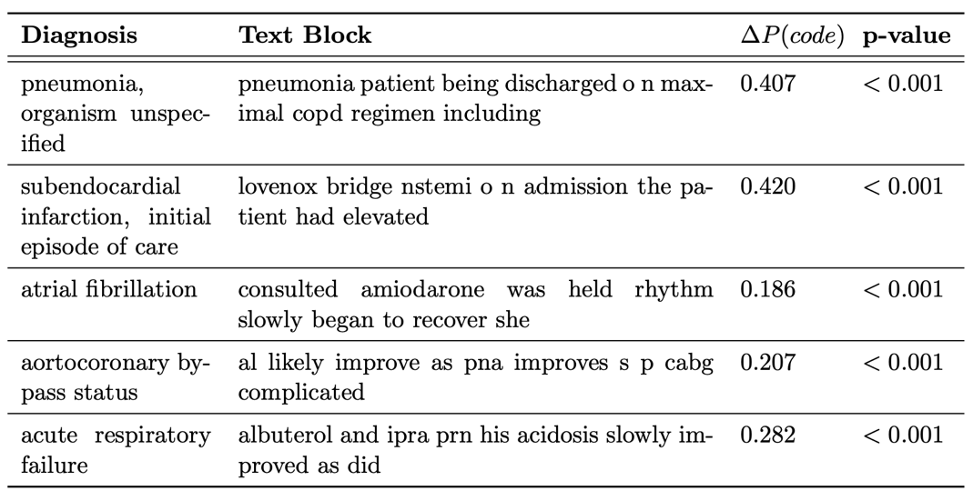
MSP Example Output
MSP surfaces important text blocks according to impact on the predicted probability of the associated document labels. For example, for classifying the condition, “aortocoronary bypass status,” our method identified the following block of text as important out of 500 blocks of the same size:
“al likely improve as pna improves s p cabg complicated,”
implying the patient is “status-post” coronary artery bypass grafting and was placed on an aortocoronary bypass machine to allow the procedure to be completed.
P-values compare the rank of each block in the order designated by MSP to a random ordering of blocks masked during the masked sampling procedure iterations.
Notes:
Here you can see some example outputs from MSP.
Each text block has a measure of importance based on the impact of masking it
over many iterations.
We compute P values by comparing the ordering in terms of importance using our procedure to a random ordering.
Here we see some interesting clinical examples, like the abbreviation CABG for coronary artery bypass grafting.
Our procedure reveals that the language model used to predict disease labels from this document
keyed in on this acronym, concluding the patient had an aortocoronary bypass procedure.
For some of the other examples, the model learned to map drugs to diagnoses, and
we know this because the masked sampling procedure assigns a high importance score to these text blocks.

Slide 17
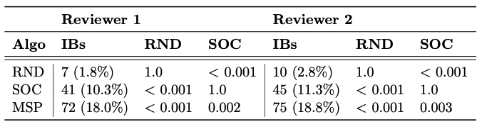
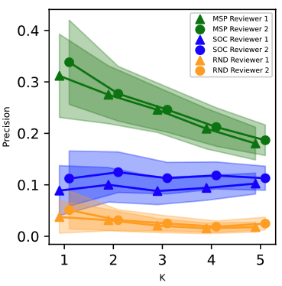
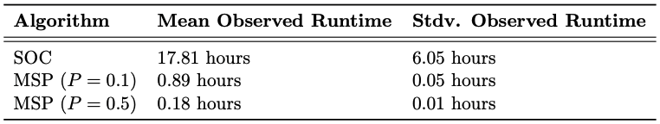
MSP Performance
We compared our masked sampling procedure (MSP) at masking probability P=0.1 to the SOC algorithm from Jin et al. and a random algorithm (RND). 400 text blocks were provided from each algorithm to two clinical reviewers who worked independently to score text blocks as informative. We report p-values comparing the proportion of informative text blocks (IBs) identified. All tests are significant with alpha=0.05 and remain significant after Bonferroni correction. The inter-annotator agreement ratio was 0.96 with Cohen’s Kappa 0.78.
Precision for the top K text blocks surfaced by MSP, SOC, and the random algorithm (RND) according to each reviewer for each document, label pair with 95% confidence intervals computed using 1000 bootstrap iterations.
We report the time it takes to compute the importance score of blocks of size B=10 tokens where for SOC we sample 100 contexts per block from a 10-block radius and for MSP the expected number of times a block is masked is 100. Runtimes were calculated by averaging over 20 randomly sampled documents of median length 1,429.5 (IQR 1,029-1,929).
Notes:
So how much better was our algorithm than the state-of-the art to which we compared…?
In the top table, we had two reviewers look at the same samples, and according to both reviewers,
you can see that MSP identified about twice as many clinically informative text blocks
as the SOC algorithm which is the Sampling and Occlusion algorithm from 2020. The differences
in number of informative text blocks is statistically significant when considering both reviewers
and remains significant when correcting for multiple testing.
Overall, the reviewer agreement is very high, adding confidence to our finding.
So, without even considering runtime, we know MSP is very effective in terms of identifying
clinically relevant text blocks. There are some natural tradeoffs in terms of precision and recall
where if our algorithm suggests more text blocks as important, it becomes more likely
that we'll capture all relevant text blocks in a document, but for both approaches we tested,
we looked at the top 5 predictions from each algorithm. We also compared to a random
algorithm and provided examples from the random algorithm to the clinicians as another baseline.
We (I) did miss a small step in implementing SOC, and we’re validating our results with another experiment.
Additionally, in this experiment, we plan to sample labels for annotation such that we can compute top-K accuracy with K up to 5.
Showing a graph of top-K results with standard errors should improve the robustness of our paper.
Even without considering clinical informativeness, the runtime of the Sampling and Occlusion method is prohibitively expensive,
especially if you start to look at pairs or triplets of important sentences.
Runtime for SOC grows quadratically with document length when considering pairs.
Here we show just the runtime for computing the importance of 10-token blocks,
which is very high for SOC, while our masked sampling procedure is about 100 times faster.
For auditing predictions on lots of documents, MSP is a feasible algorithm while SOC and similar approaches requiring more model inferences as the document length grows are prohibitively expensive.

Slide 18
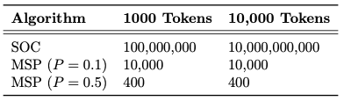
MSP for Interacting Text Block Pairs
Parallel coordinate plot for block pairs from 15 randomly sampled discharge summaries. Interaction strength is computed by comparing the importance of the pair to the sum of the individual importance scores for each text block in the pair.
MSP can be used to identify combinations of important text blocks.
Using MSP, we show the Big Bird model recognizes the joint influence on label predictions of distant text block pairs, as there are many blocks for which the importance score of the pair is greater than the sum of the scores of individual blocks.
We trained Big Bird using 64-token local attention windows, but interacting blocks are often 100s of tokens apart.
Required model inferences to compute importance scores of text block pairs sampling 100 contexts per block with SOC and setting J = 100 for MSP.

Slide 19

Summary of Contributions
Extend
Explain
A very long Big Bird LM pretrained on 5.5 million unlabeled, full-length patient medical charts (~55B tokens) which can be fine-tuned for any downstream clinical NLP task
The ability to represent entire medical charts as one sequence of up to 32,768 subwords (64x of BERT and 8x of original Big Bird)
A fine-tuned Big Bird LM for classifying 85 burdensome medical conditions with performance over 5% better in micro-average precision than current state-of-the-art DL models for predicting medical conditions from text
A novel method to identify text blocks and text block pairs that contribute to the prediction of diagnoses from medical documents
~1.7x as many clinically informative text blocks as the current state-of-the art method for explaining text classifiers
~100x faster runtime
https://photos.bandsintown.com/thumb/10428400.jpeg
Notes:
Compare to GPT3 at 500B tokens and the original Big Bird model at 10B tokens.
We’re having a good time, as Dusty Slay (anyone?)

